Slide 1
10 Days to STAAR
Ms. Sapp
YWLA
Spring 2013

Slide 2
Warm Up – Day 1
If your superhero is not yet on the board, cut it out, glue it to a sheet of paper, and tape it to the board (or window coverings in the back)
You have 12 minutes to complete the warm up.

Slide 3
Part I: Linear Functions and Their Inverses
Functions – relation in which for every input (x), there is one output, y or f(x)
Know Parent Functions!
Know Domain and Range for each!

Slide 5
Linear Functions y = mx + b
Graph f(x) = $x$ and g(x) =$\frac{3}{2}x −2$, then compare the graphs.
Find the inverse of g(x). Graph in a different color on the same graph. Then compare the graphs – what do you notice?

Slide 6
Inverse Linear Functions
Find the inverse of f(x) = -6x + 3

Slide 7
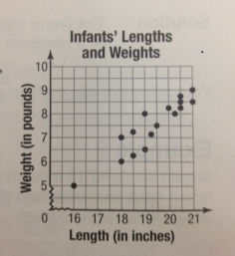
Use Linear Functions to Model Data
The scatterplot below shows the lengths, in inches, and weights, in pounds, of a random sample of newborn infants. Draw a linear model for this scatterplot. Find its equation and predict the weight of a newborn infant whose length is 17 inches.

Slide 8
Solution
Equation: Y = (7/9)x – (67/9)
Meaning: 1 lb. = 16 oz. so 7/9 lb is approx. 12 oz.
Therefore, a good prediction is that a 17-inch newborn baby will weight about 5 pounds 12 oz.
Is this prediction reasonable? Why or why not?

Slide 9
Absolute Value Functions
Graph r(x) = x – 2 + 1. State the domain and range. What is the vertex of the function?
Graph - ½ x . How was this function transformed from the parent function? What is its domain and range?
Solve x + 4 = 3 x - 2

Slide 10
Homework
Homework Day 1
Lessons 9 & 10
14 questions total
You must show ALL work to get credit! Credit will not be given if you just circle an answer

